Slide 1
Predicting Cardiovascular Disease Risk and Classifying High-Risk Patients using Machine Learning
Dubai_PG 3 :
Arif Ali, Bhagya Withanage, Harika Sridhar, Priyanshu Dwivedi, Rahul Kumar

Slide 2
Project Topic and Overview
This project aims to analyze and predict the risk of heart disease and cardiomegaly using data from clinical records and imaging datasets. By leveraging advanced machine learning techniques, the goal is to provide accurate early detection models.
Why is this important?
Our project, "Predicting Cardiovascular Disease Risk and Classifying High-Risk Patients using Machine Learning," is motivated by the significant impact of cardiovascular disease on global health. According to the World Health Organization (WHO), cardiovascular disease is the leading cause of death worldwide, accounting for over 17.9 million deaths per year. Early prediction and identification of high-risk patients can significantly improve treatment outcomes, reduce mortality rates, and enhance the quality of life for individuals with cardiovascular disease.

Slide 3
Datasets
Overview of the 3 Datasets Used
UCI Heart Disease Dataset
Cardiomegaly Image Dataset
Framingham Heart Study
Source : https://www.kaggle.com/datasets/aasheesh200/framingham-heart-study-dataset
Source : https://www.kaggle.com/datasets/redwankarimsony/heart-disease-data/data
Source : https://www.kaggle.com/datasets/rahimanshu/cardiomegaly-disease-prediction-using-cnn

Slide 4
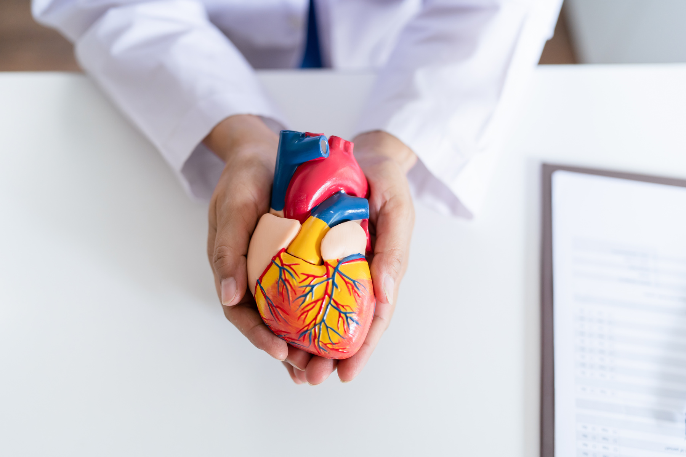
Data Set Information - Framingham Heart Study
16 columns, 4240 rows, 15 attributes
Target : Predicts the 10-year risk of future coronary heart disease (CHD).
Features : Age, cholesterol levels, blood pressure, smoking status, diabetes, etc.
Reason for Choosing:
Comprehensive data covering key heart disease risk factors, enabling a well-rounded predictive model.
Previous Usage: The dataset is used particularly to predict cardiovascular disease (CVD) and explore ways to handle missing data, given its extensive collection of health-related variables. Algorithms like K-Nearest Neighbors (KNN), MissForest have been implemented[2] for the task.

Slide 5
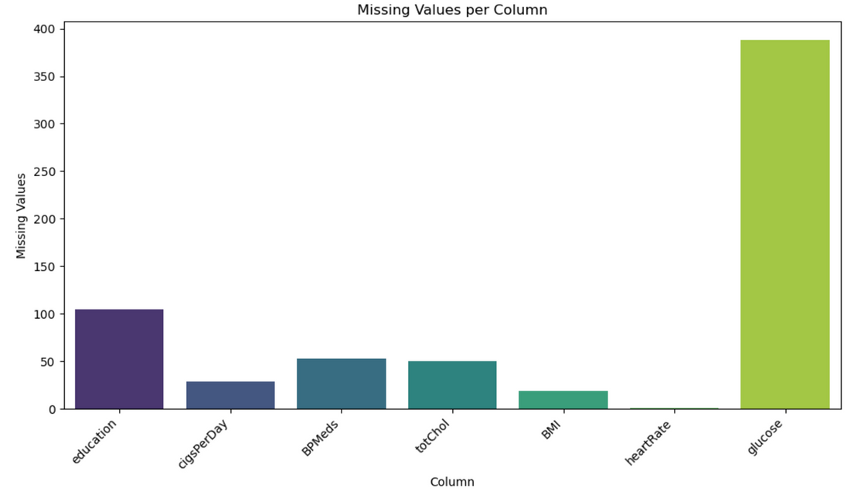
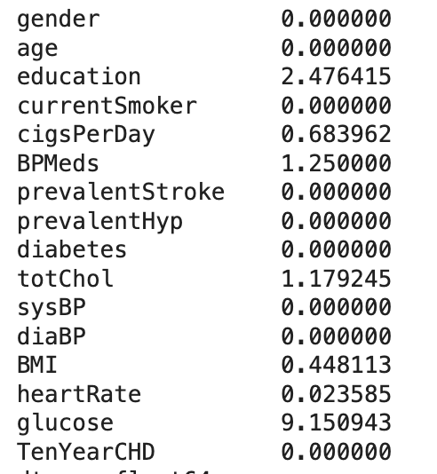
Data Exploration & Handling imbalancing
The missing values are seen mainly in the “Glucose column” followed by “education”
Glucose makes up 9% of the total dataset, 12% of the data set consists of null values
We use Upsampling and Smote to fill the null values

Slide 6
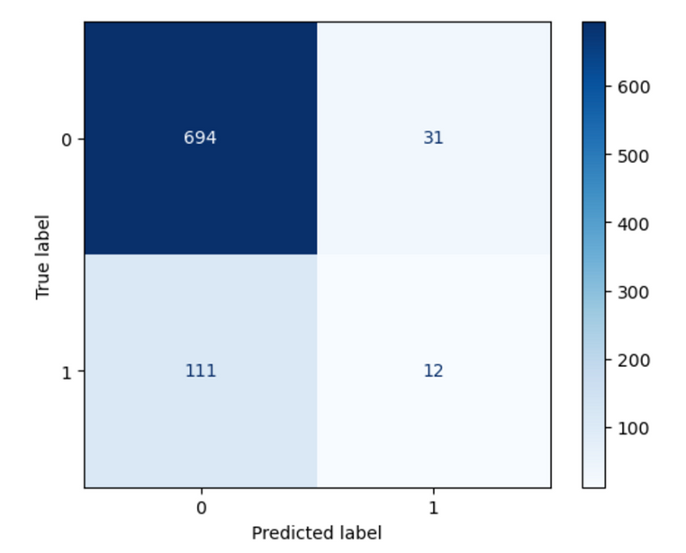
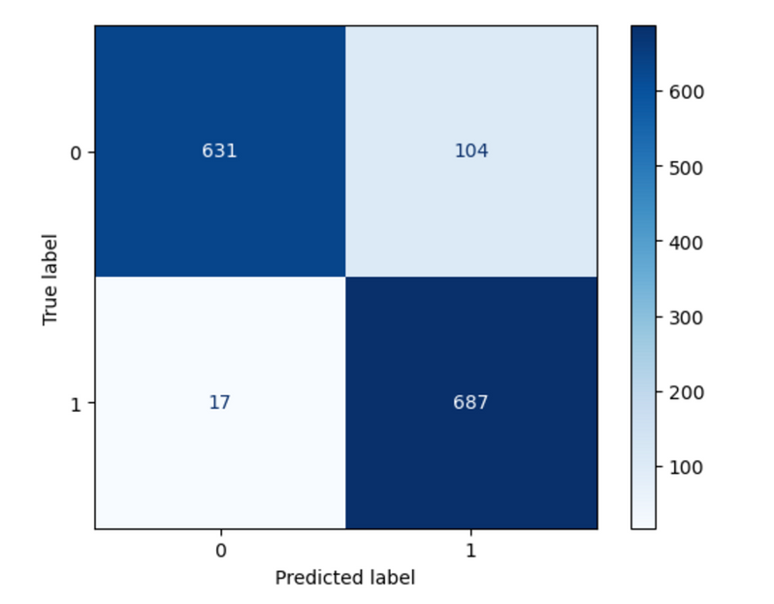
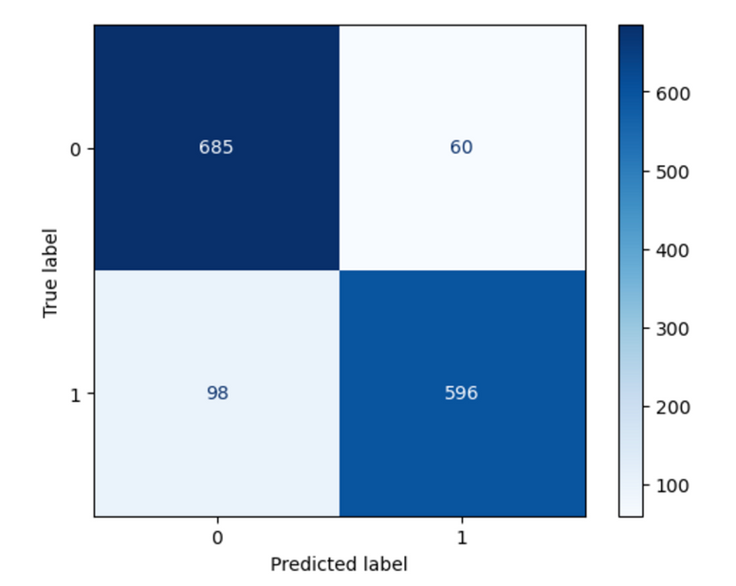
Data Exploration & Handling imbalancing
No balancing accuracy: 83%
Upsampling balancing accuracy: 92%
SMOTE balancing accuracy: 89%
Data was first tested without any corrections and then with upsampling and SMOTE separately.
Overall accuracy increased after handling the imbalance, the data set intially shows a 85-15 split for the target column (85% no disease and 15% disease)

Slide 7
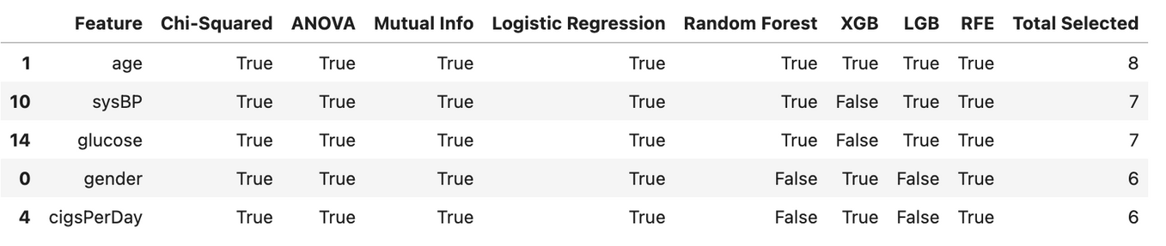
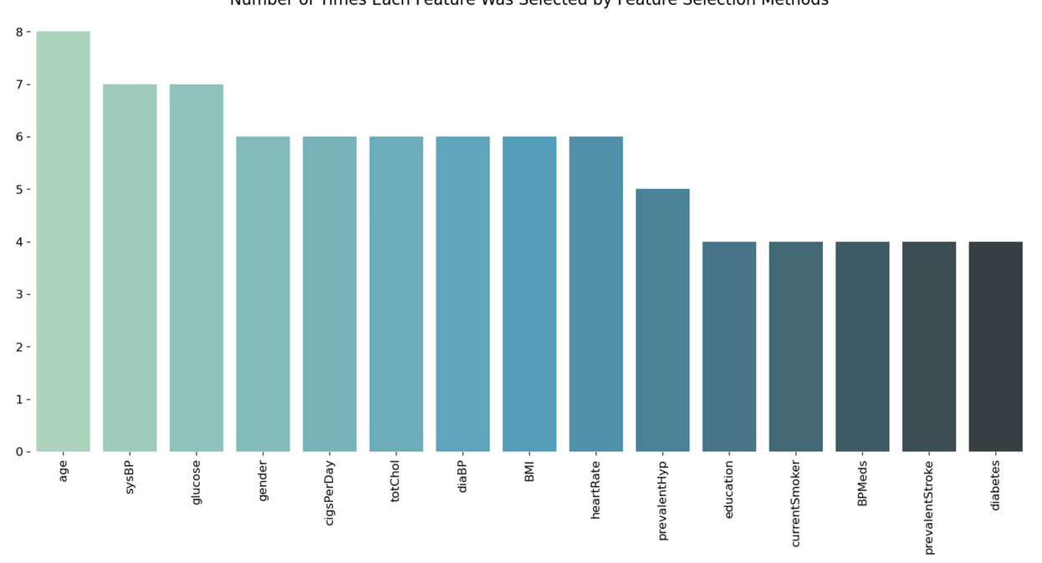
Feature Selection and Correlation
We performed feature selection using multiple methods (Chi-squared, ANOVA, Mutual Info, Logistic Regression, Random Forest, XGBoost, LightGBM, and RFE) on the dataset.
Creating a DataFrame summarizing which features were selected by each method. It also computes the total times each feature is selected and sorts the results for ranking.
Age, sysBP,glucose, cigsPerDay, totChol were selected as the top 5 columns, overall we select 10 out of the 15 total features.

Slide 8
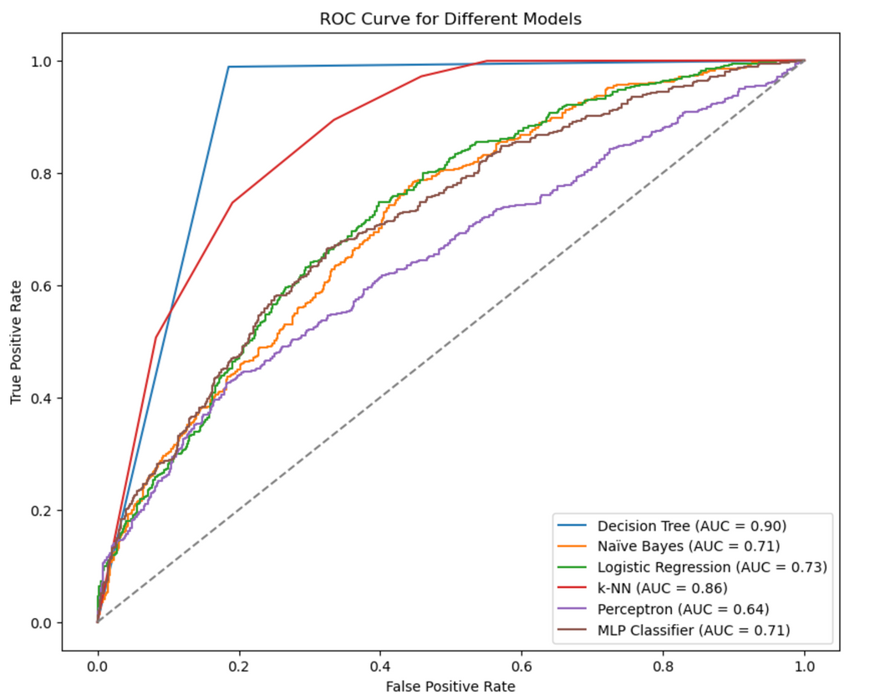
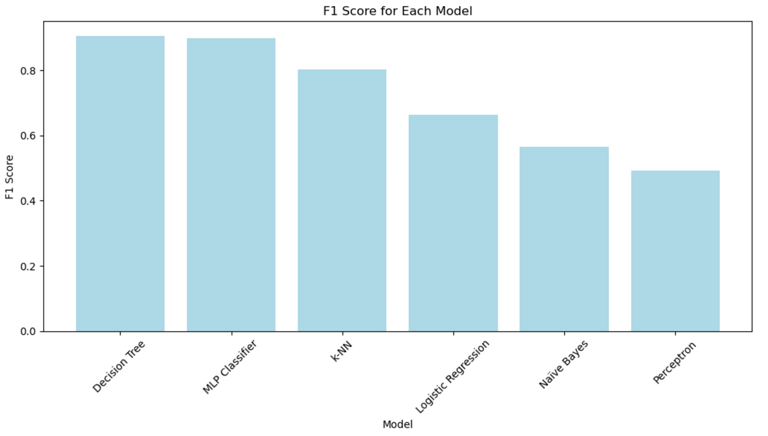
Model Training and Selecition
we train and evaluate multiple classification models on a dataset, comparing their performance metrics (Accuracy, Precision, Recall, F1 Score). The results are stored in a data frame and sorted by F1 Score for ranking.
The Decision Tree emerged as the top-performing model with excellent F1 Score, Recall, and Accuracy, closely followed by the MLP Classifier with similarly strong metrics. The k-NN showed moderate performance, while Logistic Regression and Naïve Bayes had weaker results. The Perceptron was the least effective, performing poorly across all metrics, making the Decision Tree the most reliable choice for this dataset.

Slide 9
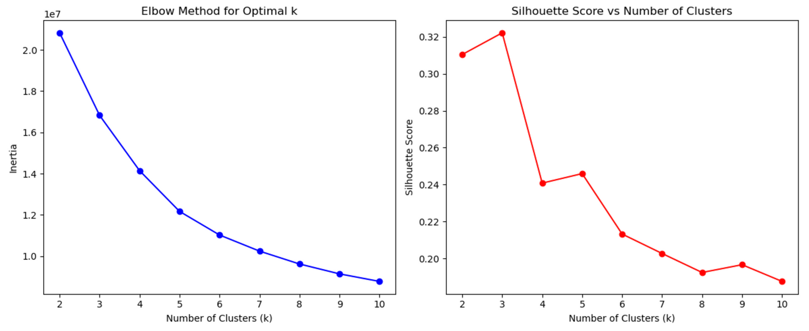
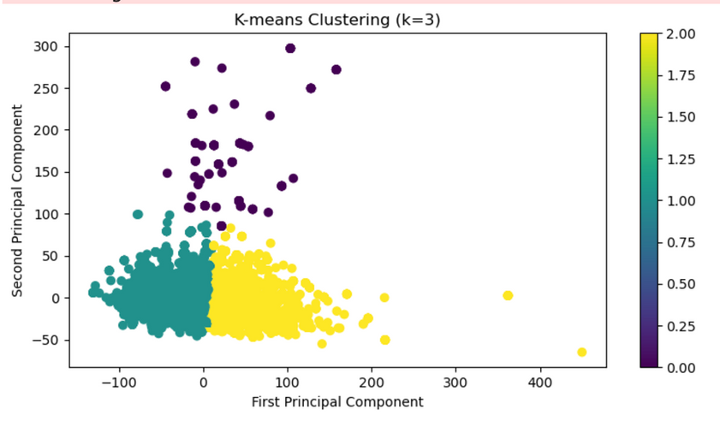
Clustering
The scatter plot visualizes K-means clustering with three clusters projected onto the first two principal components, showing clear group separations. The heatmap highlights the average feature values for each cluster, revealing distinct characteristics that differentiate the clusters.

Slide 10
Data Set Information -
UCI Heart Disease Dataset
16 columns, 920 rows, combines data from Cleveland, VA Long Beach, Hungary, and Switzerland.
Target : Predicts stages of heart disease.
Features : Age, cholesterol, chest pain type, resting ECG, max heart rate, etc.
Reason for Choosing:
Widely studied in the machine learning community, this dataset allows for analysis against previous research. It has proven reliability and coverage of diverse patient groups.
Previous usage: This dataset has been used by many researchers to predict the heart disease stages. The algorithms mainly used for this are SVM, KNN and Naive Bayes[1]

Slide 11
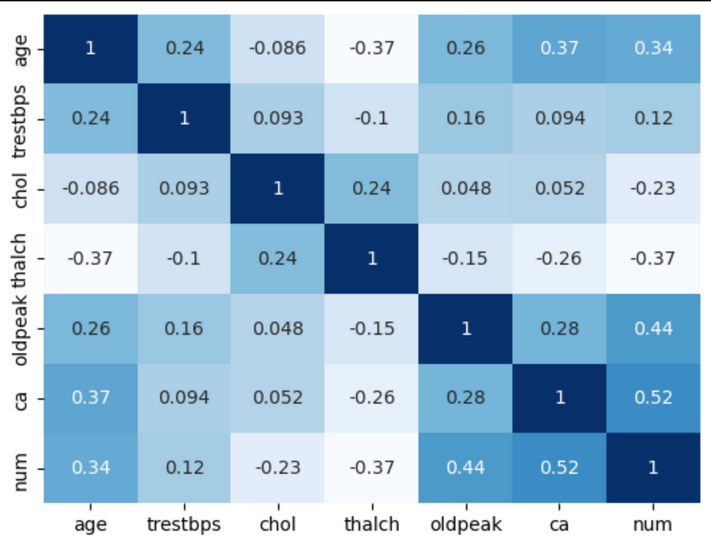
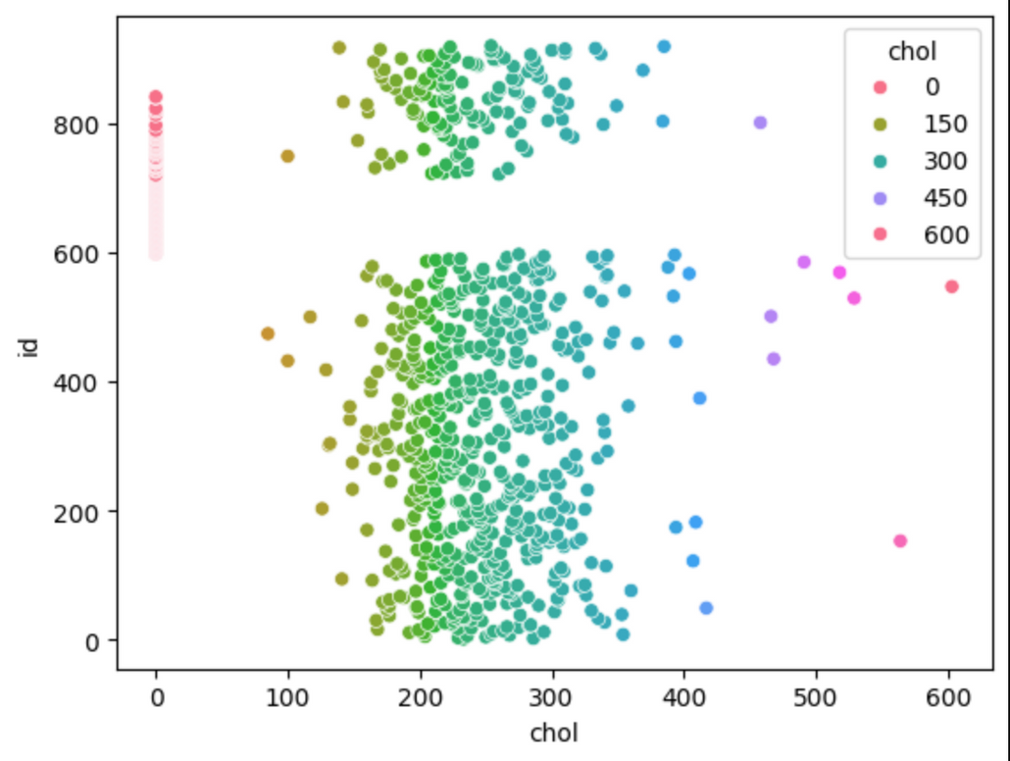
Data Visualisation - UCI Heart Disease Dataset
Average age : 53
Includes features of types : integer, string and float
Most important features are ‘ca’, ‘oldpeak’, ‘age’, and thalch.
Target column to be predicted : num - class 0 to class 4

Slide 12
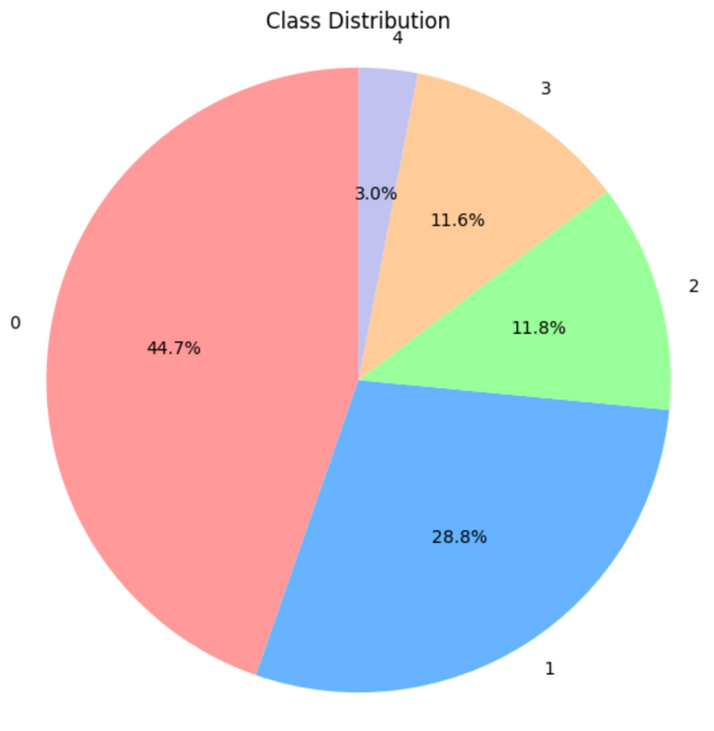
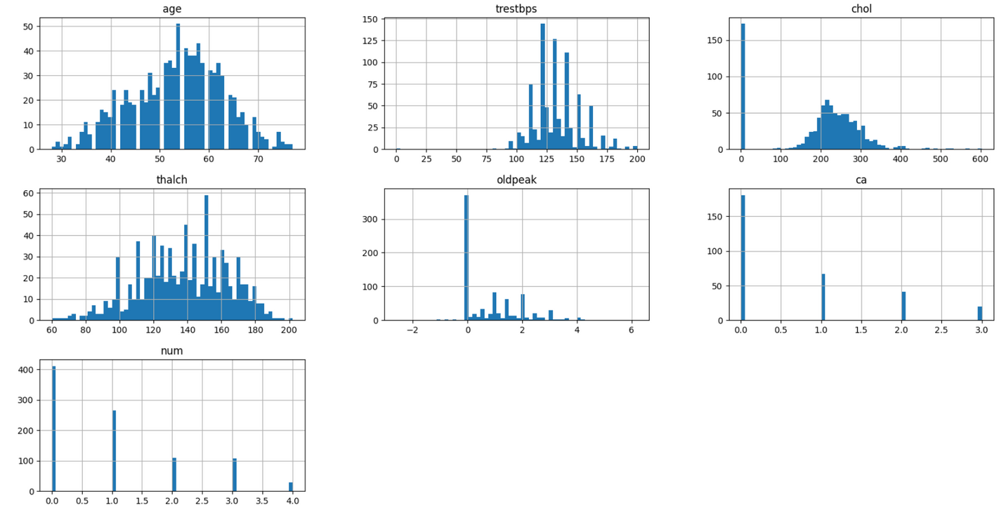
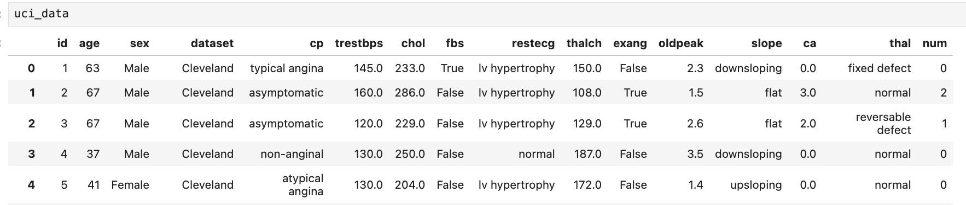
Rows from the dataset:

Slide 13
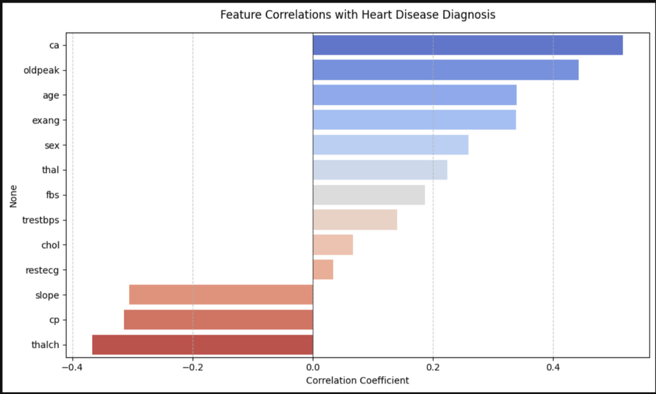
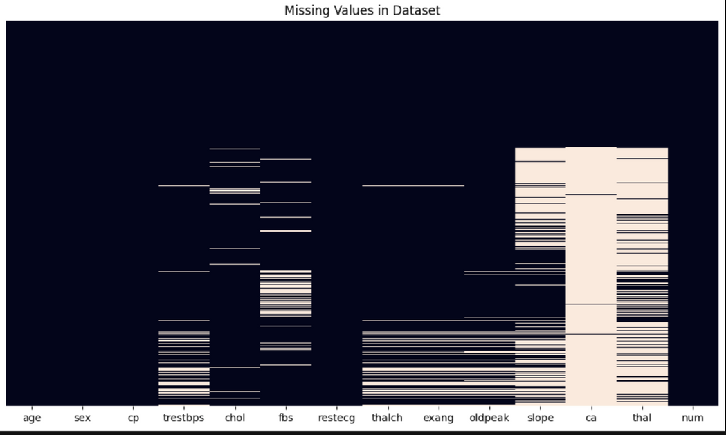
EDA & Data Preprocessing - UCI Heart Disease Dataset
Clear imbalance of data - especially for class 4
merged classes 1-4 to class 1 for better balance
Illogical values for features like cholestrol and trestbps.
Set such values to null for further processing.
Most correlated features are ‘ca’, ‘oldpeak’, ‘age’, and strong negative correlation with thalch.
Some features have many missing values, like ca and thal.

Slide 14
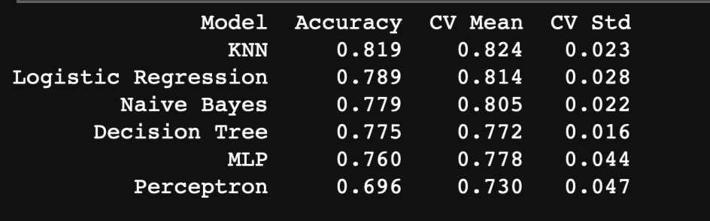
Preprocessing & Model Training - UCI Heart Disease Dataset
Features with less than 10% null values are handled by simple imputation - less likely to introduce bias.
Features with more than 20% null values are handled by Iterative Imputer - Imputes the values by predicting the value by treating it as a function of the other features.
Better preserves relations between the features.
After eliminating null values, some baseline models are applied to the dataset and the results obtained are:

Slide 15
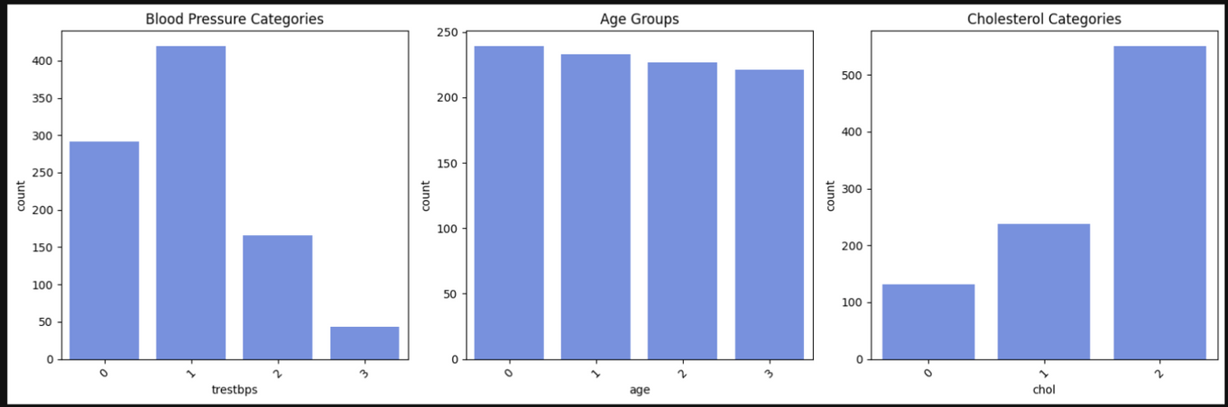
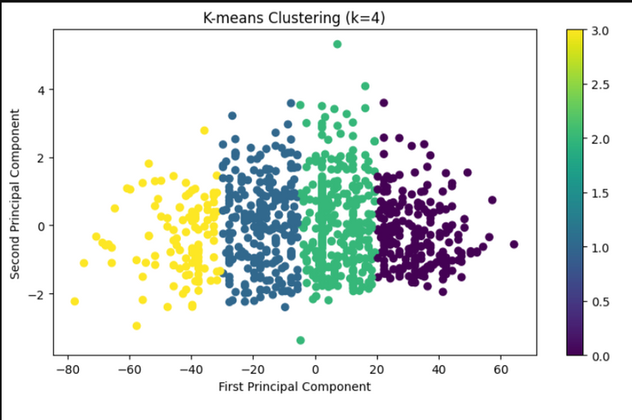
Preprocessing & Model Training - UCI Heart Disease Dataset
Some features like age, BP, cholestrol may benefit from binning, as there are actual medical ranges for these values.
Thus, binning is done on these features to help reduce the noise in data.
Quartile binning for age as it falls into a natural range, custom binning for cholestrol, as there are pre-defined medical ranges for this value, as for the resting BP feature.
On applying the classification models post-binning, better results can be observed.
Some features are better left without binning, like thalch, which is continuous heart rate values, and is more informative as such.
Clustering shows 4 distinct clusters indicating 4 different patient categories.

Slide 16
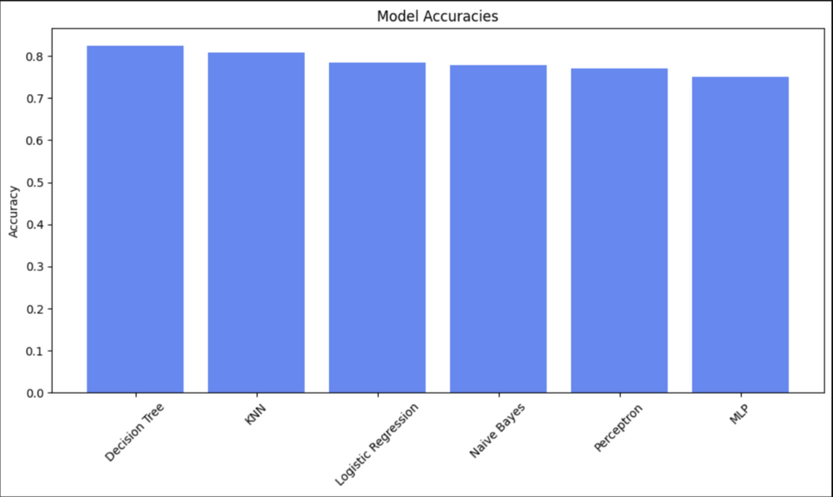
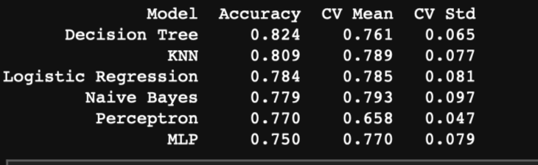
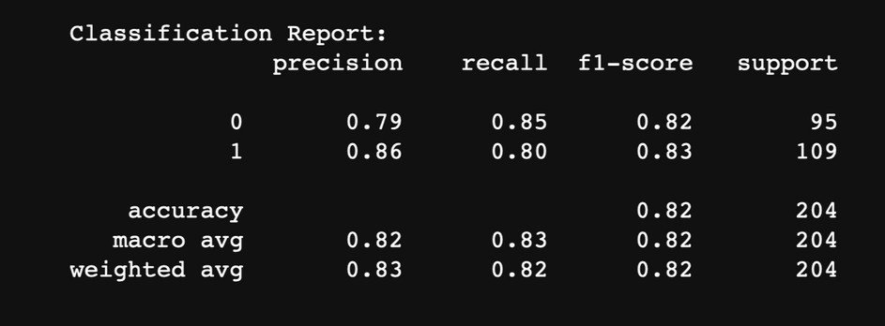
Model Performance
Decision Tree and KNN are the top performers
ROC-AUC score of 0.868 indicate strong discriminative ability
Multiple models achieve more than 75% accuracy in heart disease prediction
Good balance between precision and recall

Slide 17
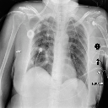
Data Set Information - Cardiomegaly Image
5552 images classified as cardiomegaly or non-cardiomegaly.
Target : Predicts presence/absence of cardiomegaly (enlarged heart).
Reason for Choosing:
The dataset introduces a visual, deep learning challenge that complements clinical data, aiming for improved diagnostic support through image analysis.
Previous usage: The enlargement of the human heart, known as cardiomegaly, has been predicted using the images in the dataset. The study involves the application of convolutional neural networks (CNNs) for automatic detection, classification, and analysis of chest X-rays to identify cardiomegaly[3].

Slide 18
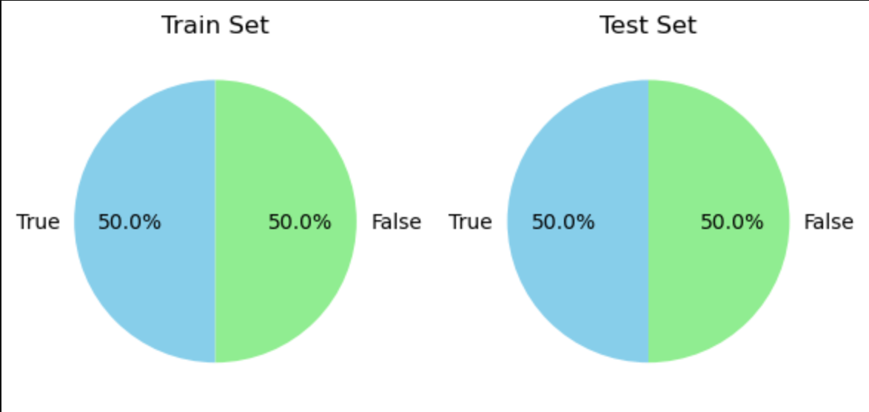
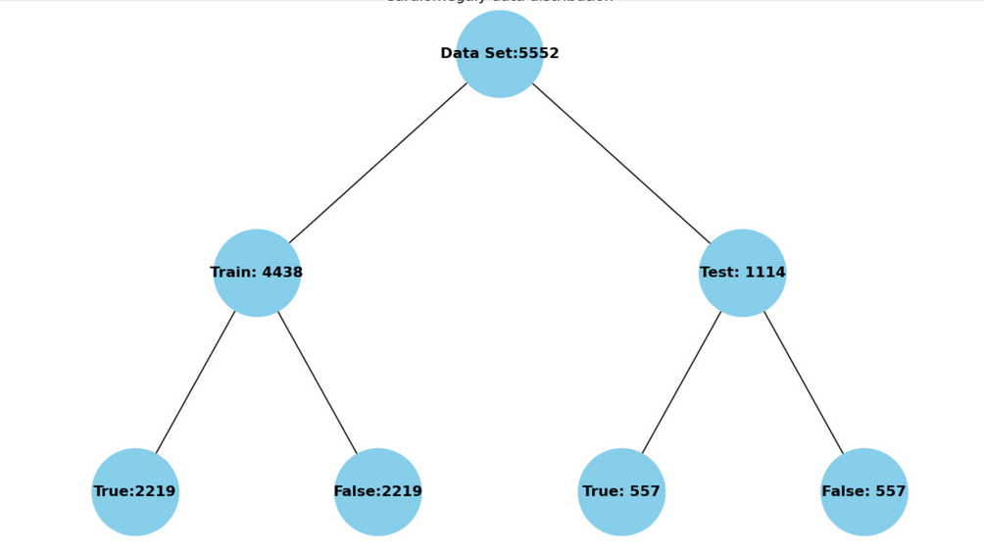
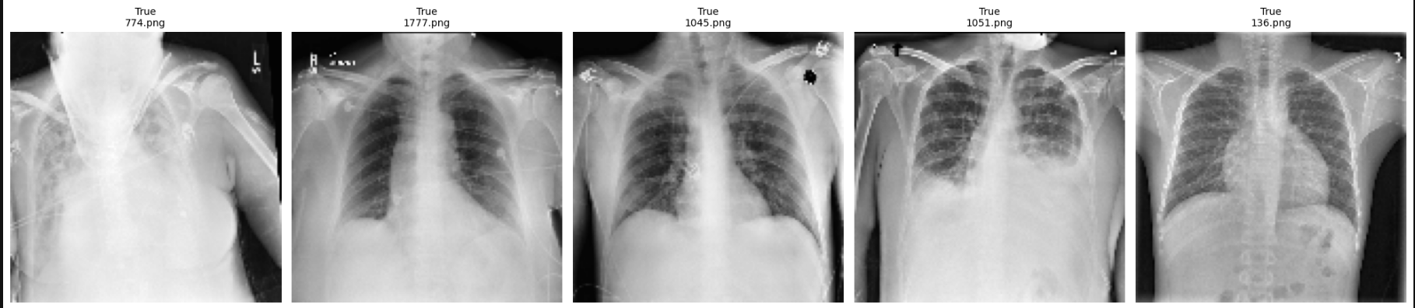
Data Visualisation - Cardiomegaly Image
Image dataset with class 50% healthy(2776 images) and 50% enlarged heart

Slide 19
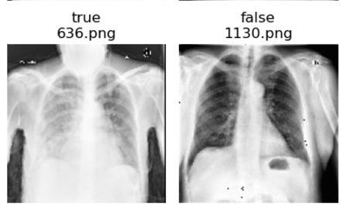
Data Preprocessing- Cardiomegaly Image
Since the images are Gray scaled, directly used this image data set with size 128*128*1.
Normalization: Normalized pixel values by dividing by 255 to get the values between 0-1 since RGB range is 0-255.
Label Encoding: Label values are encoded to 0,1 with cardiomegaly as 1 and non cardiomegaly as 0

Slide 20
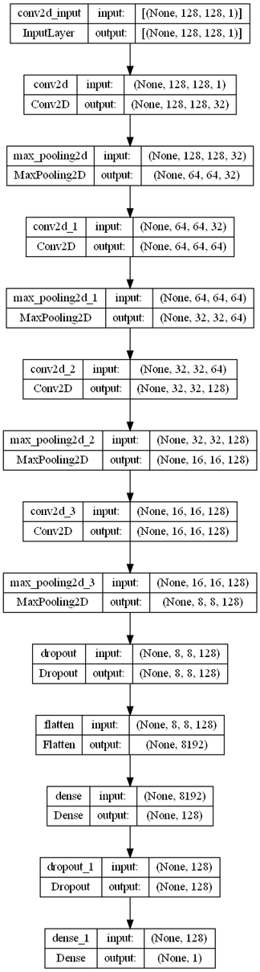
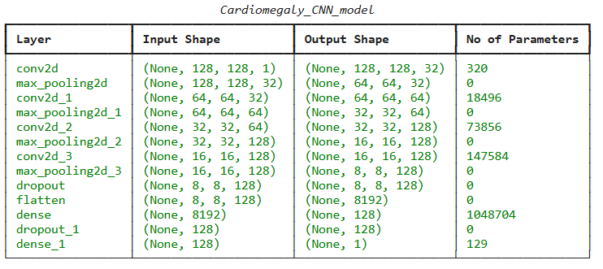
CNN Model
CNN model consists of 4 convolutional layers. 3*3 kernel used.
Feature maps of sizes 32,64,128,128 respectively for each of the 4 CNN layers and the activation function is Relu.
Pooling Layers -2*2 pooling layers with stride 1
Fully connected Layer with 128 feature maps.
Fo the Output layer the activation function is Sigmoid since range is (0,1) good for binary classification
Dropout layers are used to avoid overfitting

Slide 21
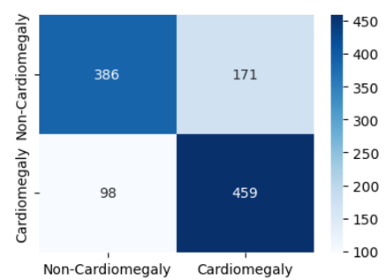
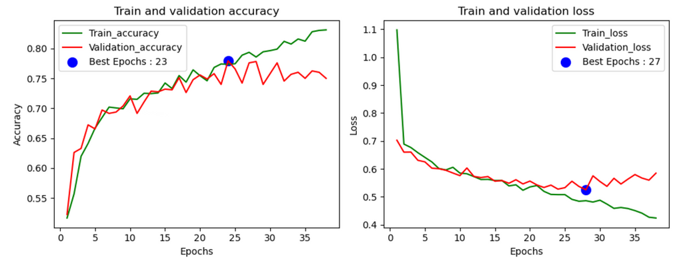
Results of Cardiomegaly Image Dataset
Train set is split into validation set with the ratio of 80:20 (in %) . Test set is strictly used only for testing.
Training is performed with different batch sizes, learning rates and cross fold validation.
early stopping used to avoid overfitting.
1. Batch sizes.
Model test with different batch sizes. 32, 64,128, 256, 512
According to the evaluation the best batch size was 64.

Slide 22
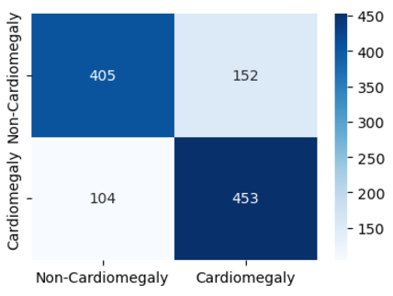
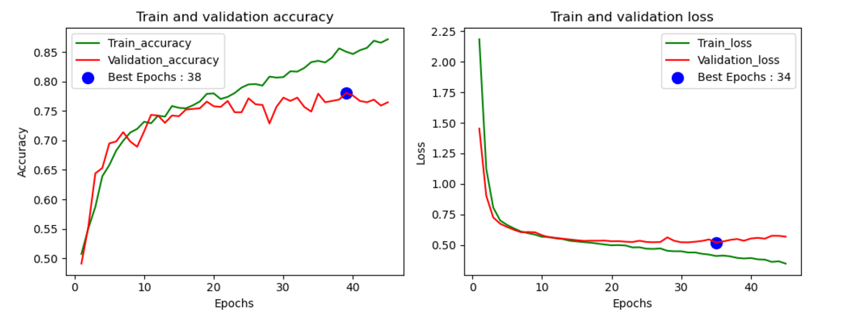
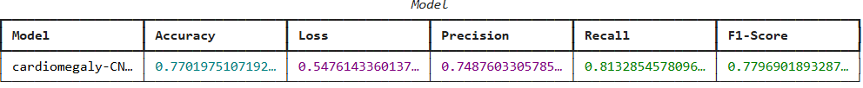
Results of Cardiomegaly Image Dataset
1. Learning rates.
Model trained and evaluated with different learning rates. 0.1,0.01,0.001,0.0001
According to the evaluation the best learning rate is 0.0001

Slide 23
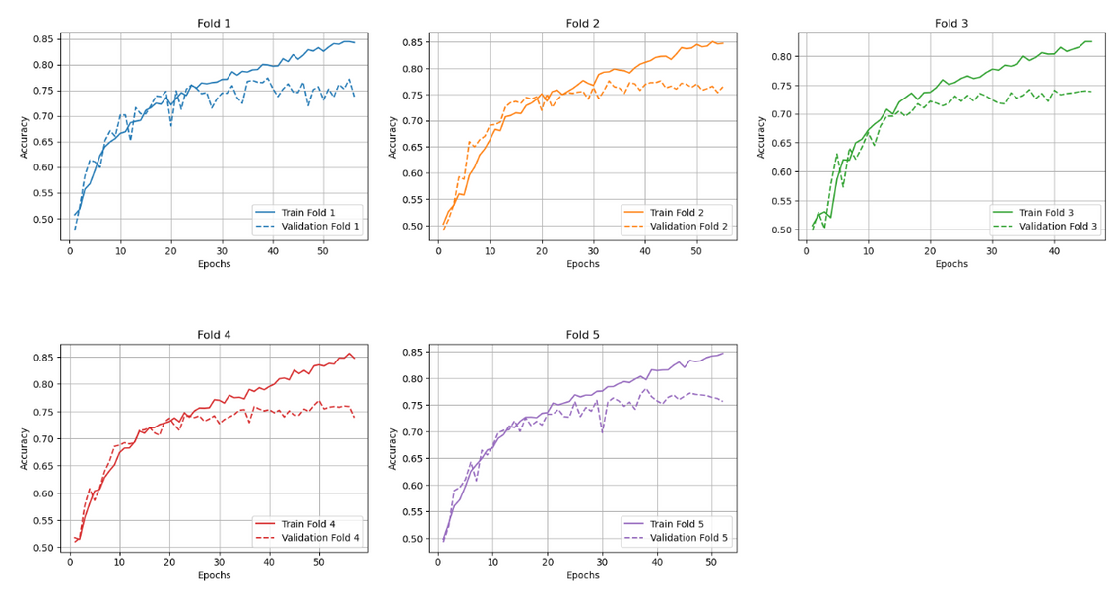
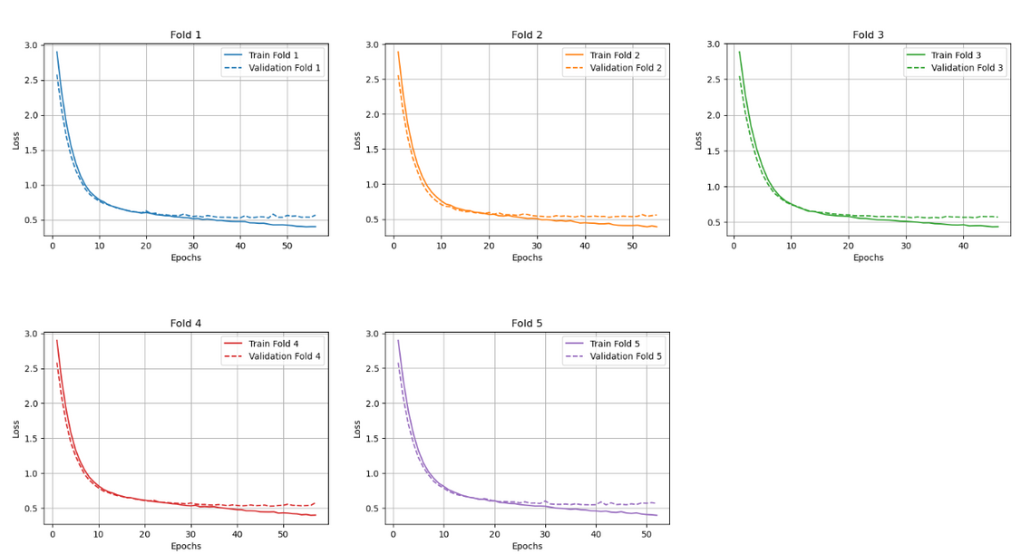
Results of Cardiomegaly Image Dataset
3. Cross fold validation
Cross fold validation used for model train and evaluation.
Summary of cross fold validation:
avg_accuracy:0.7628366231918335
average_loss:0.5431429386138916
avg_precision:0.7544566953022211
avg_recall:0.7827648114901258
avg_f1_score:0.7672559576801605

Slide 24
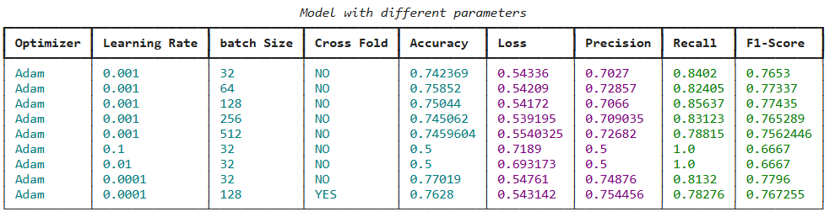
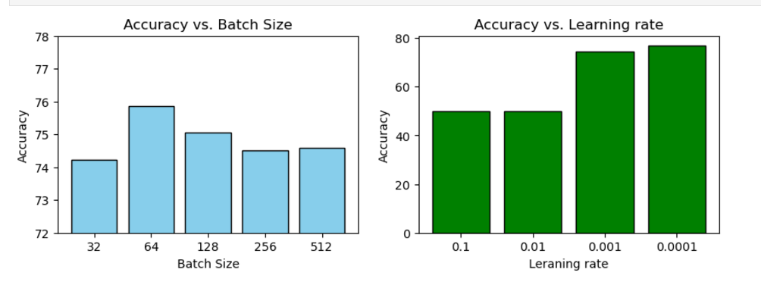
Results of Cardiomegaly Image Dataset
Summary

Slide 25

Thank you very much!

Slide 26
References
[1] Machine Learning Classifications of Coronary Artery Disease By Ali Nassif, Omar Mahdi, Qassim Nasir, Manar Talib, Mohammad Azzeh. 2018. Published in ArXiv.
[2] K. Psychogyios, L. Ilias and D. Askounis, "Comparison of Missing Data Imputation Methods using the Framingham Heart study dataset," 2022 IEEE-EMBS International Conference on Biomedical and Health Informatics (BHI), Ioannina, Greece, 2022, pp. 1-5, doi: 10.1109/BHI56158.2022.9926882.Xiv.
[3] Ahmed, D., Hamood, E. (2024). Prediction of Cardiomegaly Disease Using Deep Learning. In: Bhattacharya, A., Dutta, S., Dutta, P., Samanta, D. (eds) Innovations in Data Analytics. ICIDA 2023. Lecture Notes in Networks and Systems, vol 1005. Springer, Singapore. https://doi.org/10.1007/978-981-97-4928-7_16

